Slide 1
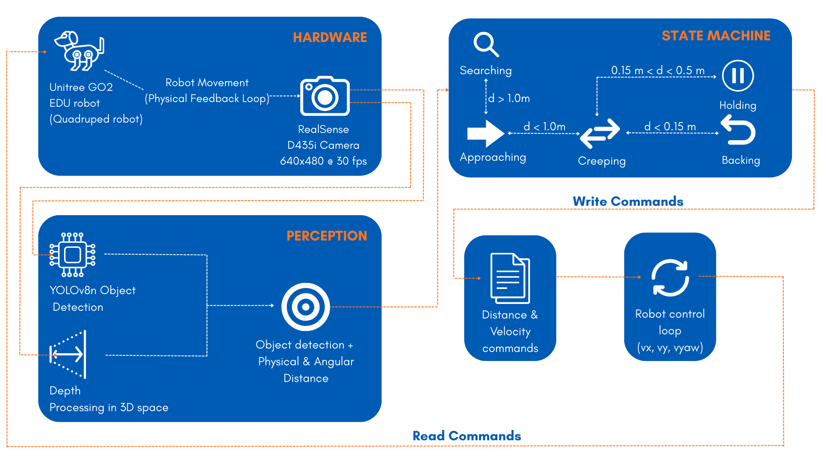
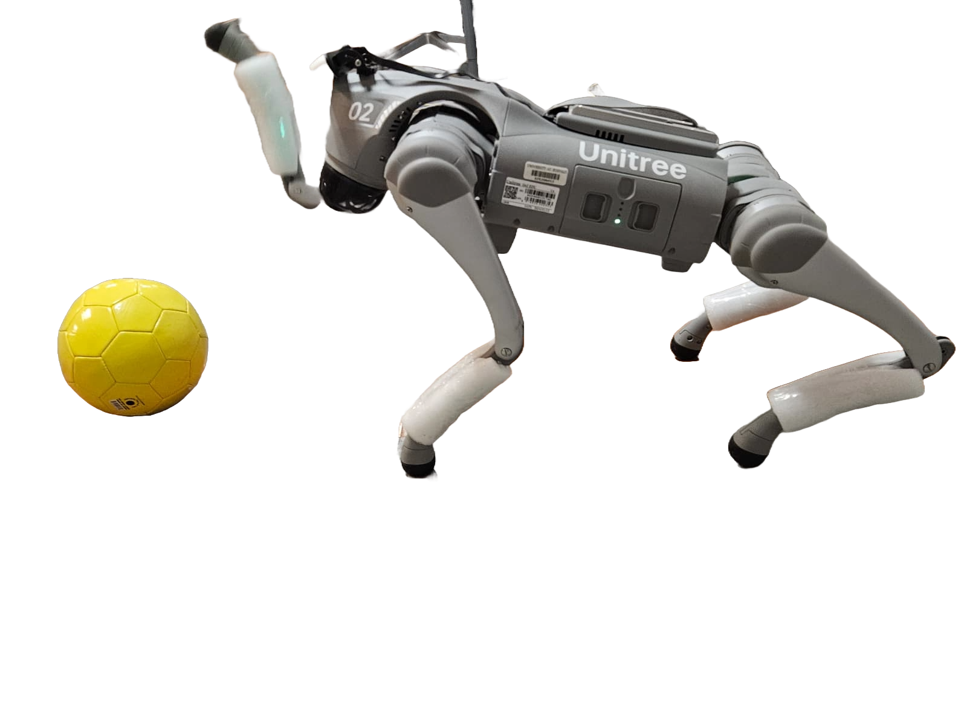
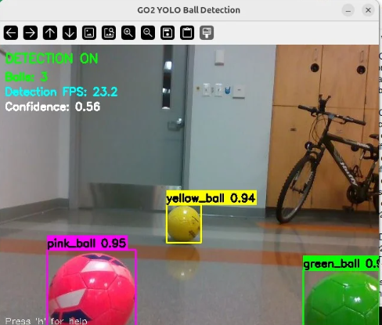
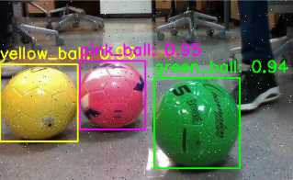
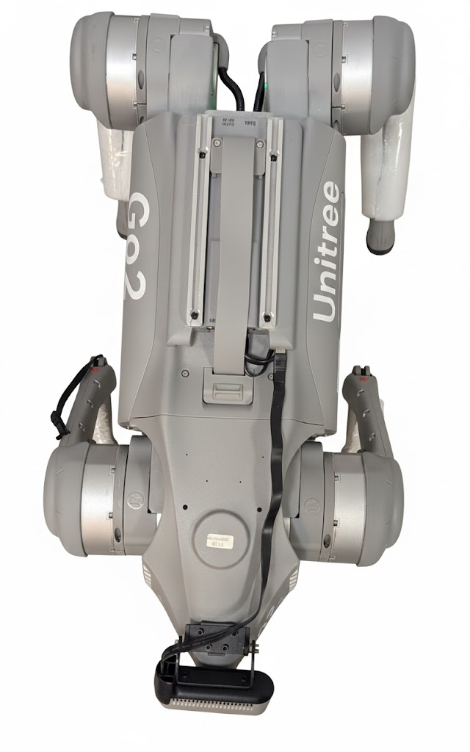
BOLT- Behavioral Object Locomotion & Tracking
For Unitree GO2 Robot
Atharva Prabhu, Sahil Sawant (EAS 563 AI Capstone under Prof. David Doermann)
The Problem
Quadruped robots require robust vision-guided navigation to perform autonomous tasks in complex, real-world environments. Unitree Go2, while highly mobile, does not natively provide the autonomous vision-to-motion control required to execute prolonged and responsive behavioral following of dynamic targets.
Our Solution: Implement a real-time autonomous ball-tracking system with sub-50ms latency using decoupled Computer Vision and motion control architecture to perform continuous behavioral following.
Background & Challenges
2D Vision - Inaccurate estimation of object distance
Non-Linear Dynamics & Leg Control - Translating high-level velocity commands into low-level joint torque
Tightly Coupled Architecture - Vision commands outpace motion control, causing the robot to use stale target data.
Intrinsic Camera Calibration – Accurate calculation of focal length are essential to avoid errors in real-world distance and pose calculations.
Accomplishments
Enabled real time, 3D depth-based object tracking
Closed loop object detection and motion control behavior
Averaging 48ms latency (Worst case 61ms)
Robust and works in multiple environments and lighting.
Our Methodology
Camera → Quantized Yolov8n →State Machine → Motion Commands → Robot moves, updating the camera
Limitations
Detection range constraints
Camera Field of View Restrictions
Occlusion
Motion Blur
Future Applications and Scope
Enhanced multi target tracking
Voice-Guided Tracking & Relocalisation
Challenging Environments
Why it matters:
Search and Rescue operations
Service Robotics
Warehouse Automation
Key Objectives:
Real-time 3D depth-based object tracking
Seamless Computer Vision & Robot Motion
Low latency control loop
Operational Stability
Learning Outcomes
Facilitating Models on Edge Devices
System Design and Architectures for robots
Hardware Integration
Network Management
End-to-End Deployment
State-Based Control System
SEARCH: Rotate to find ball (vyaw=0.4)
APPROACH: Fast forward (vx=0.30, d>1.0m)
CREEP: Slow precision (vx=0.15, d<1.0m)
HOLD: Maintain target (vx=0, 0.15m<d<0.5m)
BACKUP: Safety reverse (vx=-0.15, d<0.15m)
SEARCH
References:
https://github.com/unitreerobotics/unitree_sdk2
APPROACH/
CREEP
BACKUP
Acknowledgments:
A2IL Lab, University at Buffalo | Lab advisors
Department of Computer Science & Engineering
School of Engineering & Applied Sciences
aprabhu5@buffalo.edu | sahilshi@buffalo.edu

